Slide 1
Romeo and Juliet

Slide 2
Two households, both alike in dignity, In fair Verona, where we lay our scene, From ancient grudge break to new mutiny, Where civil blood makes civil hands unclean. From forth the fatal loins of these two foes A pair of star-cross'd lovers take their life; Whole misadventured piteous overthrows Do with their death bury their parents' strife. The fearful passage of their death-mark'd love, And the continuance of their parents' rage, Which, but their children's end, nought could remove, Is now the two hours' traffic of our stage; The which if you with patient ears attend, What here shall miss, our toil shall strive to mend.

Slide 3
They hold an ancient grudge against each other and start fighting again
There are two very similar families in Verona
Two households, both alike in dignity, In fair Verona, where we lay our scene, From ancient grudge break to new mutiny, Where civil blood makes civil hands unclean. From forth the fatal loins of these two foes A pair of star-cross'd lovers take their life; Whole misadventured piteous overthrows Do with their death bury their parents' strife. The fearful passage of their death-mark'd love, And the continuance of their parents' rage, Which, but their children's end, nought could remove, Is now the two hours' traffic of our stage; The which if you with patient ears attend, What here shall miss, our toil shall strive to mend.
Each family has a child, they are fated to fall in love and commit suicide
Their unfortunate deaths will stop their families fighting.
Their fatal love and the family feud
A feud which only the their deaths could end, will be played out on the stage
And if you listen with patience, then our play will help you understand their story.

Slide 4
A Feud
Montague
Capulet

Slide 5
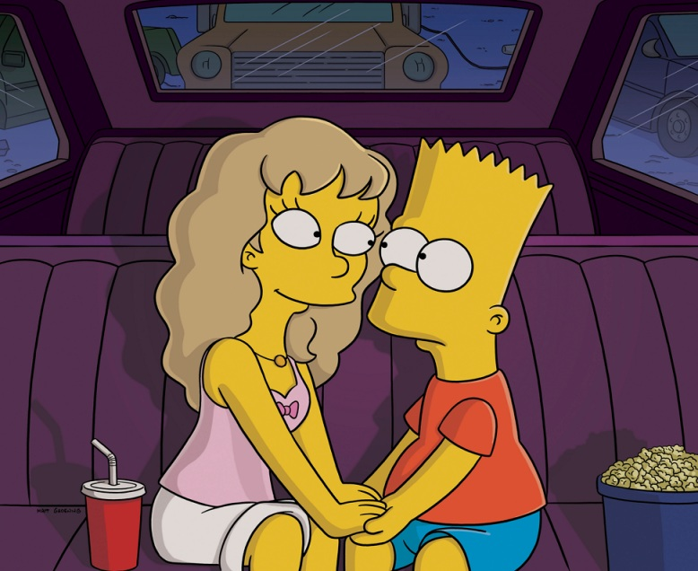
Romeo is in love…
Rosaline
Romeo

Slide 6
…but it is unrequited.
Rosaline doesn’t love Romeo

Slide 7
Let’s have a party!
Romeo’s best friend, Mercutio, hears there’s a party at the Capulet house and to cheer Romeo up he decides to get them an invite.
Mercutio

Slide 8
Juliet
When we first meet Juliet she is waiting for her father’s party to begin. The party is set up in order for her to meet Paris, the man her father wants her to marry.

Slide 9
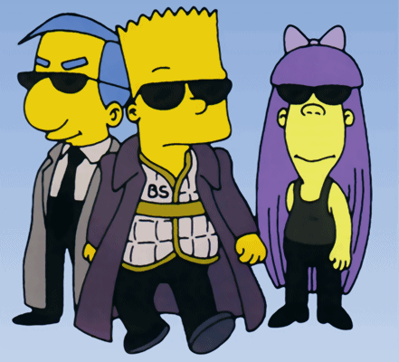
Incognito
Romeo
Mercutio
Benvolio
Knowing that they’re not supposed to be there, Meructio, Romeo and their friend Benvolio turn up at the party in disguise.

Slide 10
Love at first sight
Rosaline is forgotten as Romeo spots a beautiful girl across the ballroom.

Slide 11
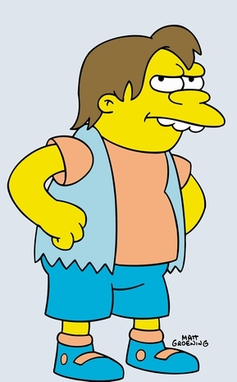
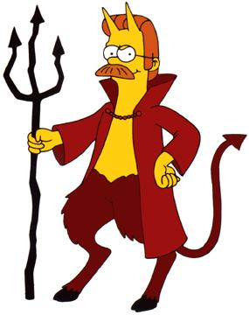
Tybalt
Juliet’s cousin realise that the Montague’s have gate-crashed the party. He is not impressed.
Not wanting to ruin the party, Capulet tells Tybalt to ignore them for the night.

Slide 12
My only love…my only hate
Romeo is devastated to find out that Juliet is a Capulet, his sworn enemy.

Slide 13
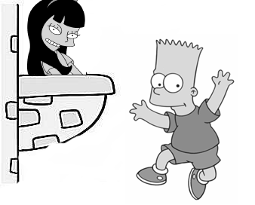
What’s in a name?
Putting their differences aside, Romeo Seeks Juliet out and finds her gazing at the stars from her balcony.
They talk of love even as Juliet worries that he will be murdered if her were found in her garden. Eventually Romeo leaves but not before Juliet tells him that she will send someone to speak with him the next day to make sure of his intentions.

Slide 14
Friar Lawrence
Nurse
Romeo speaks to the friar about marrying Juliet.

Slide 15
A secret love
Romeo and Juliet marry in secret.

Slide 16
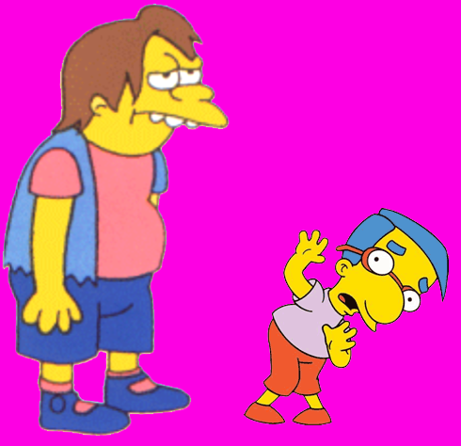
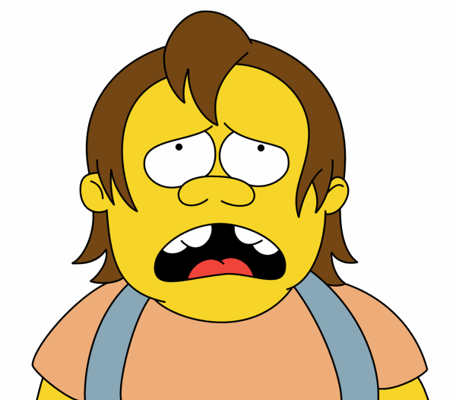
Blood and death
Tybalt kills Mercutio who in turn curses both the Montagues and the Capulets for his death.
Romeo, thou have killed me!

Slide 17
Banishment
As punishment for killing Tybalt Romeo is told that he must run away and never return to Verona.

Slide 18
A cunning plan

Slide 19
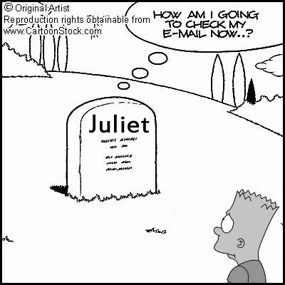
A tragic end
Romeo hears of Juliet’s death and comes to see her. He has brought poison with which to kill himself and drinks it all. Waking up Juliet is devastated and impales herself on his sword. Both are dead.

Slide 20
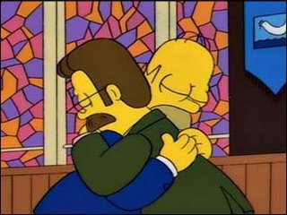
Friends at last
Following the death of their children, Montague and Capulet put their differences aside – the tragedy unites them.

