Slide 1
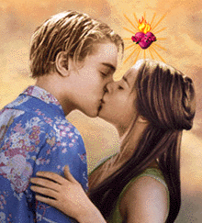
Romeo and Juliet

Slide 2
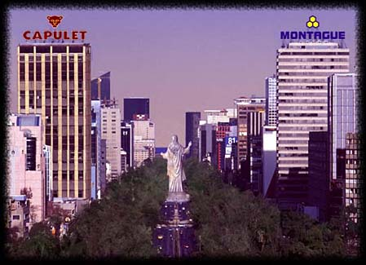
Two households…

Slide 3
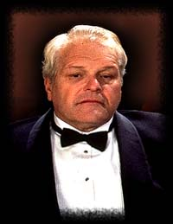
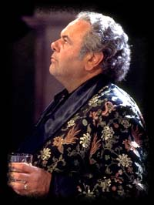
Both alike in dignity…

Slide 4
In fair Verona,
where we lay our scene…

Slide 5
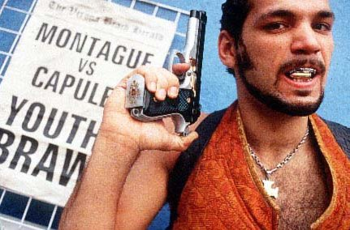
From ancient grudge
break to new mutiny…

Slide 6
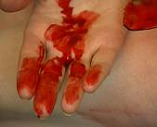
Where civil blood
makes civil hands unclean.

Slide 7
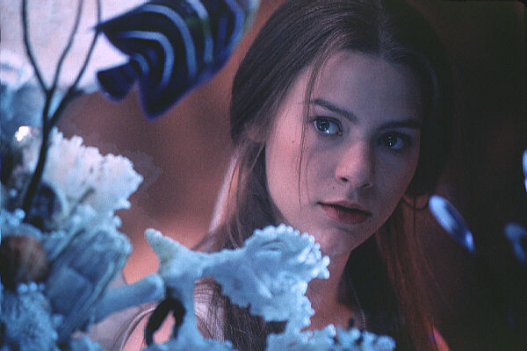
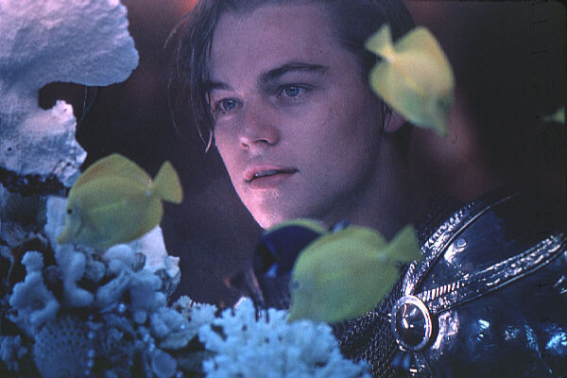
From forth the fatal
loins of these two foes,

Slide 8
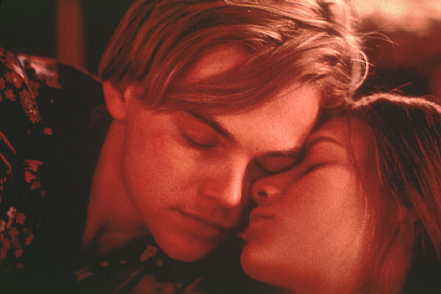
A pair of star-cross’d
lovers take their life.

Slide 9
Facts
Written by William Shakespeare in about 1591
Based on Arthur Brooke's The Tragicall History of Romeus and Juliet

Slide 10
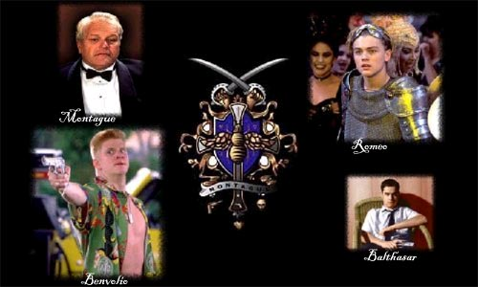
Montagues

Slide 11
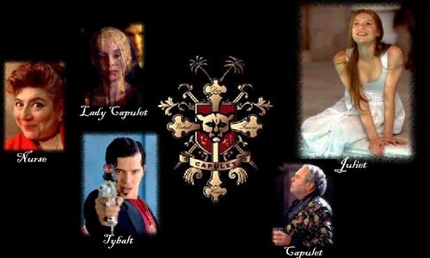
Capulets

Slide 12
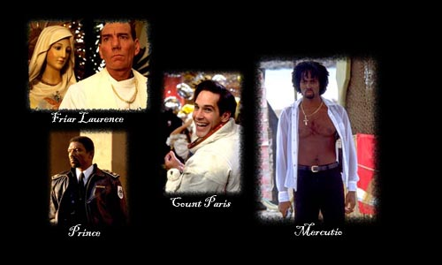
Others

Slide 13
Look for…
Puns
Allusions
Metaphor
Personification
Oxymorons
Paradoxes
Foreshadowing

Slide 14
Puns
A pun is a humorous play on words.
Mercutio – “Nay, gentle Romeo, we must have you dance.”
Romeo – “Not I, believe me. You have dancing shoes / With nimble soles; I have a soul of lead…” (Act I Sc. 4)

Slide 15
Allusions
An allusion is a reference to a well known work of art, music, literature, or history.
“At lovers’ perjuries, they say Jove laughs.” (Act II, Sc. 2)
Jove is another name for Jupiter, the Roman King of the Gods.

Slide 16
Metaphor
A metaphor is a direct comparison between two unlike things.
Romeo – “But, soft! what light through yonder window breaks? / It is the east, and Juliet is the sun.” (Act II Sc. 2)

Slide 17
Personification
Personification occurs when an inanimate object or concept is given the qualities of a person or animal.
Juliet— “For thou wilt lie upon the wings of night / Whiter than new snow on a raven’s back. / Come, gentle night, come, loving, black-brow’d night” (Act III Sc. 2)

Slide 18
Oxymorons
An oxymoron describes when two juxtaposed words have opposing or very diverse meanings.
Juliet – “Beautiful tyrant! fiend angelical!” (Act III Sc.2)

Slide 19
Paradoxes
A paradox is statement or situation with seemingly contradictory or incompatible components.
Juliet – “O serpent heart, hid with a flowering face!” (Act III Sc. 2)

Slide 20
Foreshadowing
Foreshadowing is a reference to something that will happen later in the story.
Juliet – “Give me my Romeo; and, when he shall die, Take him and cut him out in little stars, And he will make the face of heaven so fine That all the world will be in love with night And pay no worship to the garish sun.” (Act III Sc. 2)

Slide 21
Themes
Light and dark
Time
Fate

Slide 22
Light and Dark
Look for references to light and dark:
References to “light” words, such as “torches,” “the sun,” adjectives that describe light (“bright”)
References to “dark” words, such as “night” and “gloom”

Slide 23
Time
Look for references to time:
References to “time” words, such as “hours”
References to the passage of time, especially if it seems “rushed”

Slide 24
Fate
Look for references to fate:
Look for instances where events are blamed on “fate,” “destiny,” or “the stars”

Slide 25
The
End

